Slide 1


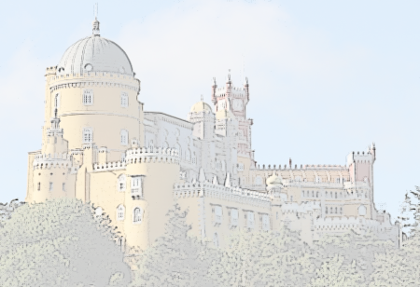

SASA Dictionary as the Gold Standard for Good Dictionary Examples for Serbian
Ranka Stanković¹, Branislava Šandrih¹, Rada Stijović²,
Cvetana Krstev¹, Duško Vitas¹, Aleksandra Marković²
¹ University of Belgrade,
² Institute for Serbian Language SASA
SMART LEXICOGRAPHY, Sintra, Portugal, 1–3 October 2019.

Slide 2
Overview
Introduction
aim, role, SASA-Dataset
SASA Dictionary
retro-digitization, modernisation, current practice
Features of Dictionary Examples
role, extraction, APIs
Feature analysis
gold and control dataset, distribution
Preliminary Model for Identifying GDEX
Future work and concluding remarks

Slide 3
Introduction
Aim of the research
providing support for building different kinds of monolingual descriptive dictionaries of Serbian language
Role of dictionary examples
“key microstructural element” of a dictionary
SASA-Dataset
SASA - DSA - thesaurus, meant primarily for native speakers
covers standard language and vernacular, for the last 200 years
20 volumes published, digital version of 5 volumes is being used
basic criteria: informativeness, typicality, naturalness, intelligibility

Slide 4
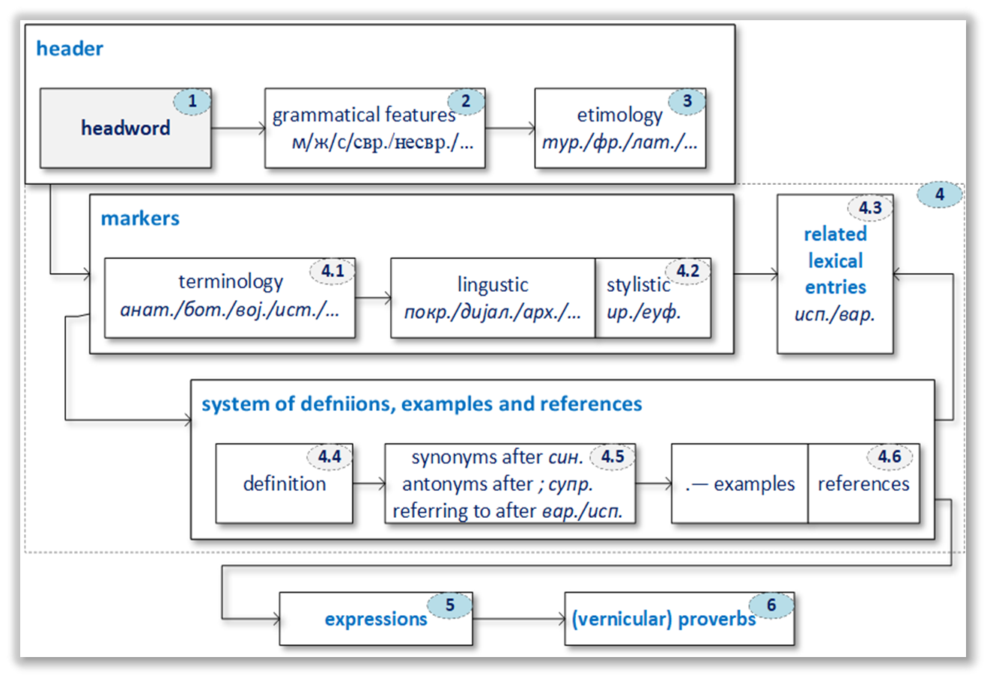
SASA Dictionary
Retro-digitization of the SASA Dictionary
The modernisation of work began in 2016 with the digitization of the printed volumes and paper-slips
A formal description of dictionary entry was produced
A lexical database model was developed

Slide 5
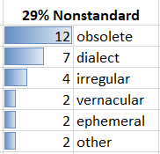
SASA Dictionary
Towards modernization of the SASA Dictionary-Making
The dataset of examples derived from the SASA dictionary can serve various purposes:
to procure examples for new volumes of the SASA dictionary and for new dictionaries of Serbian
to find key (optimal) values for features used in the GDEX function
to develop an ML
model for example classification
(standard/non-standard lexis)
- of marked lexis

Slide 6
SASA Dictionary
Current Practice of Dictionary Example Selection
2 to 6 examples for each LU, according to the following criteria:
example should clearly show the meaning of the LU
examples have to be from different parts of SC language territory
examples should be from different periods, listed chronologically
examples should be written by renowned writers
example should show different relations of the headword with other words
every example should represent a finished syntactic whole

Slide 7
Current Practice of Dictionary Example Selection
Interventions on examples
The analysed dataset
~60,000 dictionary entries
~105,000 lexical units
70% of entries have examples
Summary of interventions:
66% of examples were not modified;
20% had one shortening and no insertions;
6% had more than one shortening and no insertions;
5% had an insertion but were not shortened;
2% had both insertions and shortenings

Slide 8
The Features of Dictionary Examples
The Role of Example Features
The initial set of features was
inspired by (Kilgarriff et al., 2008; Kosem, 2017), and
guided by recapitulation in (Kosem et al., 2019)
GDEX for Serbian ranks candidate sentences
Gold standard for the development of our method
dictionary examples from 5 out of 20 volumes
examples were manually selected by experienced lexicographers
multiple check-ups (through several phases)

Slide 9
The Features of Dictionary Examples
Feature Extraction (14 out of 41 )
Character-based:
sentence_length: Number of all characters
no_digits: Number of digits
no_weird_chars: Number of characters ("#$%&\'()*+-/:;<=>?@[\\]^_`{|}~’„”…)
no_commas: Number of commas
no_punctuation: Number of all punctuation marks
Token-based:
No_all_tokens: Number of all tokens
avg_token_len: Average token length
max_token_len: Max token length
no_all_words: Number of all words (contiguous sequence of letters)
avg_word_len: Average word length
no_capitalised_words: Number of words that begin with uppercase, which are not at the beginning of the sentence
no_rare_tokens: Number of tokens with frequency ≤ threshold in the referent corpus
avg_freq_in_corpus: Average word frequency in the referent corpus
Syntactic features:
no_pronouns: Number of tokens tagged as pronouns

Slide 10
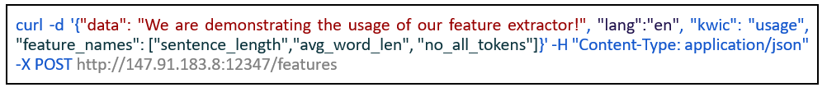
The Features of Dictionary Examples
API for feature extraction http://gdex.jerteh.rs/
and the fields are:
  data (string) – mandatory, contains text for which features are being extracted
  lang (string) – optional (the default value is “sr” for Serbian, but most of the features can be extracted for English, as well)
  kwic (string) – optional (only for headword-dependent features)
  feature_names (list of strings) – optional (if omitted, returns list of all feature values)
For the given example, the output would be:

Slide 11
Feature analysis – Gold Dataset
Examples from the SASA Dictionary supplied
volume, headword, POS, linguistic labels
type of editor’s intervention, bibliographical source
Size of the gold corpus
133,904 examples comprising 1,711,231 words
Three types of partitioning were used:
published volume (D01, D02, D18, D19 and D20)
type of lexis/language (DSS standard, DNS non-standard)
POS of the headword (N, V, A, ADV and X)

Slide 12
Feature analysis – Control Dataset
Digital library Biblisha
collection with contemporary novels (CN) :
7 novels written by contemporary Serbian writers
7 novels written in German and translated to Serbian
domain knowledge from two scientific journals (SJ)
Infotheca, Journal for Digital Humanities
Underground Mining Engineering
SrpKor – Corpus of contemporary Serbian (DP)
17 issues of the daily newspaper Politika published in 2001–2010
Serbian ELTeC Collection of old novels (ON)
10 novels and excerpts from 15 novels published 100 or more years ago

Slide 13
Feature analysis – Control Dataset
Sentence segmentation by the System for Serbian text processing, based on
comprehensive e-dictionaries
local grammar in the form of finite-state automata
Concordances extracted
using appropriate regular expressions
to serve as candidate examples for headwords in the volumes to come
The size of the control corpus
30,104 sentences, comprising 908,980 words
sample of 2,752 candidate examples (taken from all parts of the control corpus) was manually evaluated by two lexicographers as follows:
1,434 examples as inadequate (useless)
723 as inadequate but improvable by major changes
441 as good examples in which only minor changes are required
154 as very good examples for which no changes are required

Slide 14
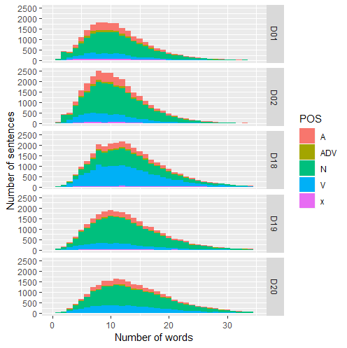
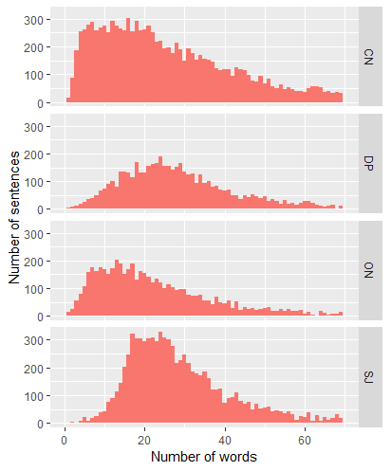
Feature analysis
Feature distribution in the gold dataset of good examples
  Histogram of the number of words in examples
Notes:
The comparison by volumes didn’t show any significant deviation
In volume D18 the number of verbs (blue) is greater than in the other volumes, which can be explained by numerous verbs in this volume beginning with o, derived by productive prefixes od- (allomorph ot-) and o-.

Slide 15
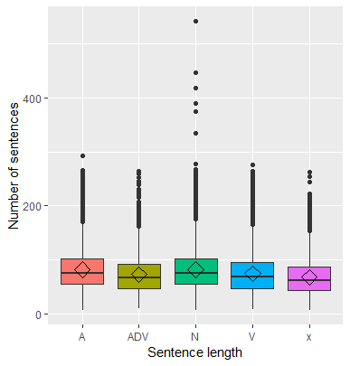
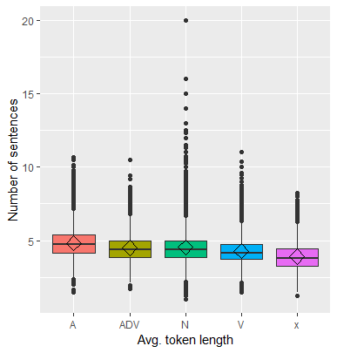
Feature analysis
Feature distribution in the gold dataset of good examples
  Boxplots showing sentence/token length per POS in SASA Dictionary
Notes:
The comparison by volumes didn’t show any significant deviation
In volume D18 the number of verbs (blue) is greater than in the other volumes, which can be explained by numerous verbs in this volume beginning with o, derived by productive prefixes od- (allomorph ot-) and o-.

Slide 16
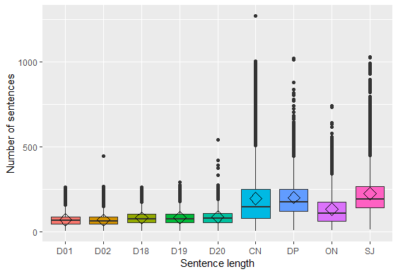
Feature analysis
Feature distribution on both corpora
  Boxplot of sentence (example) length (in number of characters) per partition
Notes:
Figure 3 presents a boxplot diagram of sentence length statistical values per each partition (volume and text collection). It can be observed that the sentences in the control dataset partitions are longer than in any volume of the Dictionary, that the dispersion for contemporary novels (CN) is the highest, that the average length of sentences in journals and daily papers is similar, and that old novels (ON) have shorter sentences than the contemporary ones (CN).

Slide 17
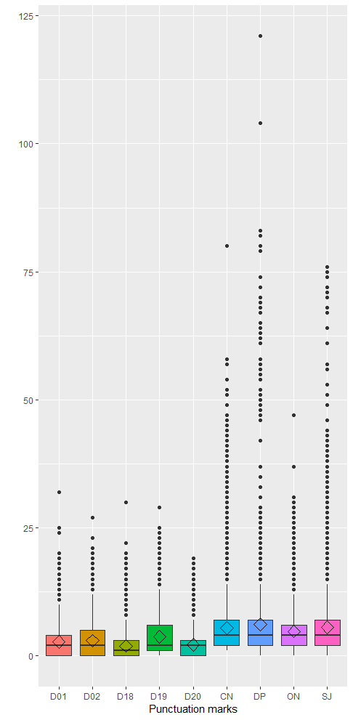
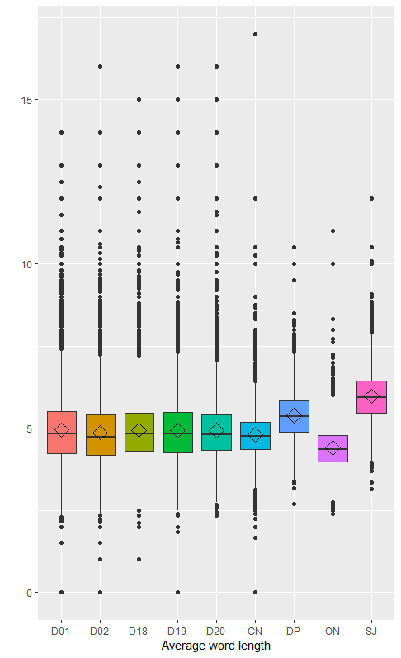
Feature analysis
Feature distribution on both corpora
  Boxplots of the number of punctuation marks and average word length per partition
Notes:
Figure 3 presents a boxplot diagram of sentence length statistical values per each partition (volume and text collection). It can be observed that the sentences in the control dataset partitions are longer than in any volume of the Dictionary, that the dispersion for contemporary novels (CN) is the highest, that the average length of sentences in journals and daily papers is similar, and that old novels (ON) have shorter sentences than the contemporary ones (CN).

Slide 18
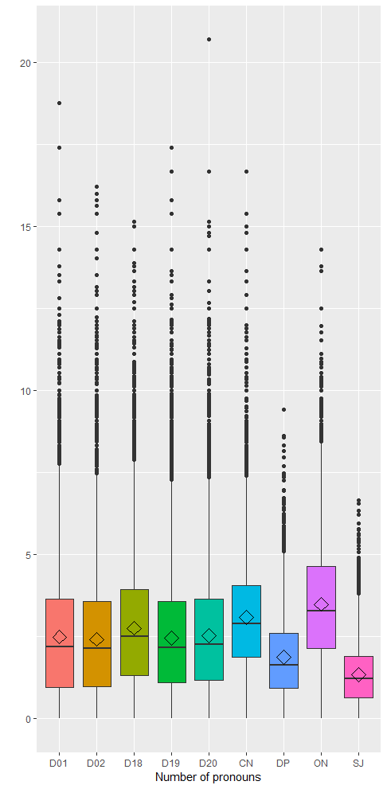
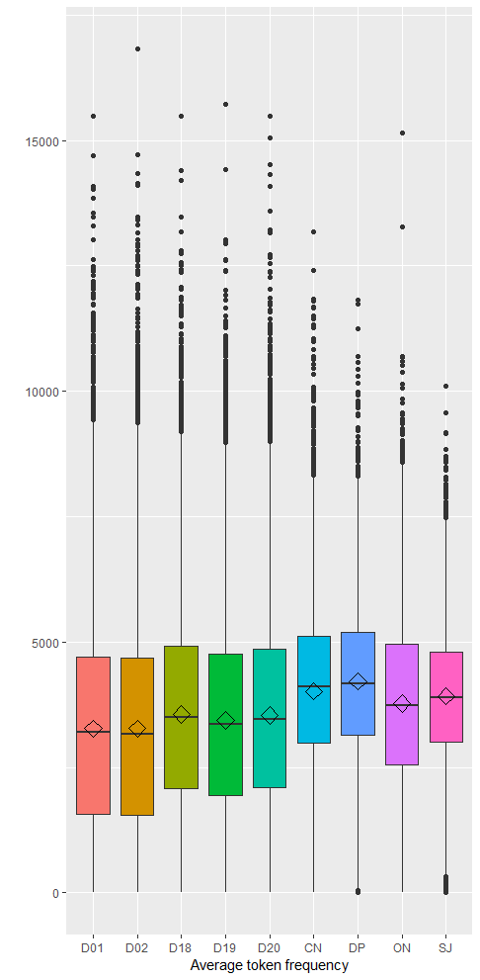
Feature analysis
Feature distribution on both corpora
  Boxplot of the number of pronouns and token frequency per partition
Notes:
Figure 3 presents a boxplot diagram of sentence length statistical values per each partition (volume and text collection). It can be observed that the sentences in the control dataset partitions are longer than in any volume of the Dictionary, that the dispersion for contemporary novels (CN) is the highest, that the average length of sentences in journals and daily papers is similar, and that old novels (ON) have shorter sentences than the contemporary ones (CN).

Slide 19
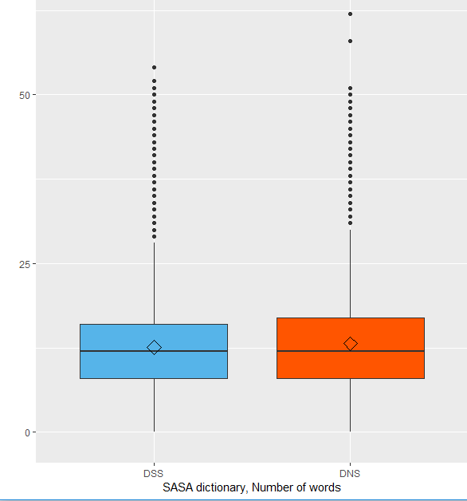
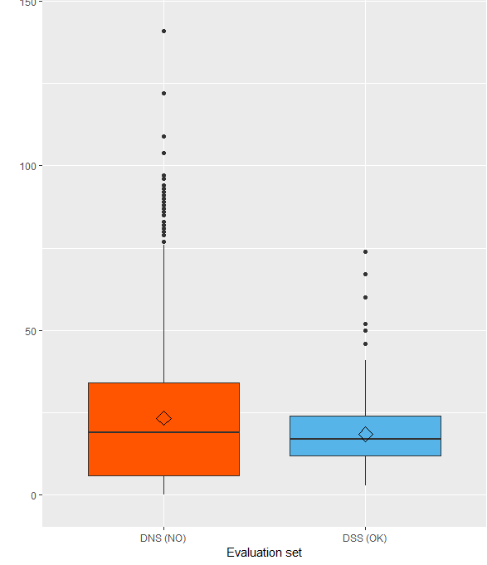
Feature analysis
Feature distribution on both corpora
Boxplot of the number of words per language type partitions
standard Serbian (DSS) and non-standard (DNS)
Notes:
Figure 6 (left) shows that standard Serbian (DSS) and non-standard (DNS) in the dictionary have a similar distribution of the number of words in the examples, which means that there is no difference in this respect between good examples illustrating standard or non-standard lexis. On the other hand, the evaluated dataset has a wider range for inadequate examples (DNS (NO)), while similar distribution with those in the dictionary. Results for other features also show that there are no significant differences between examples in DSS and DNS.

Slide 20
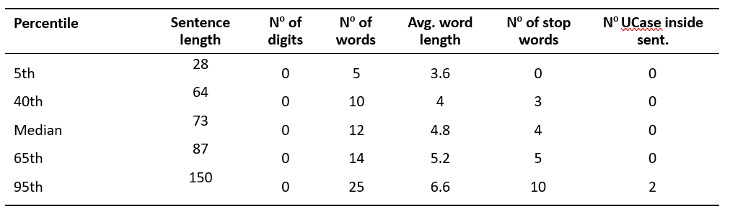
Feature analysis
Data summary from the SASA dictionary
  Percentiles used for the ranking function
  The system for semi-automatic identification of GDEX relies on feature statistics including the detection of examples that are not appropriate for standard language use

Slide 21
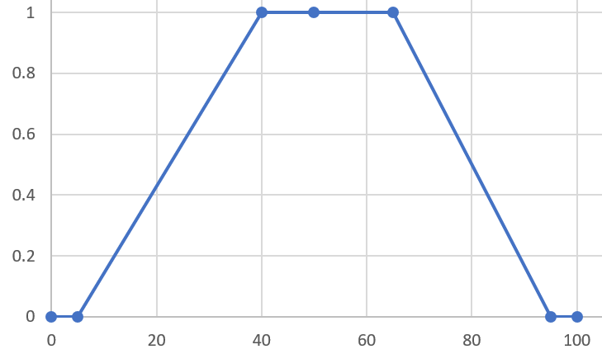
Preliminary Model for Identifying Good Dictionary Examples
Filtering and ranking
rules obtained from analysed data (feature vectors)
GDEX function
inspired by the state of the art functions:
optimal_ interval function
four key percentiles from the gold SASA dataset
feature values <= first and > last are assigned 0.01
in the middle interval all scores are 1
between them a linear interpolation function is used
greylist function
two key values are used (5th and 95th percentiles)
values lower of the 5th are assigned a score of 1
higher than 95h a score of 0
between them a linear interpolation function is used
combined into a single score.
blacklist(), greylist() and optimal_interval().
40th and 65th percentile of the SASA dictionary for number of words are the same as values in the example given to the Sketch engine...

Slide 22
Preliminary Model for Identifying Good Dictionary Examples
Analytic hierarchy process (AHP)
each feature value converted to a value from 0 to 100
numerical weight (priority) assigned to it
the sum of all weights is 1
Precision calculated on evaluation set
for the first 100 ranked, the precision was 0.77
for the first 200 the precision was 0.70
for the first 400 the precision was 0.65
for the first 1000 the precision was 0.6
Impro-vement
additional rules: evaluators noticed patterns indicating inadequacy
sentences beginning with adverbs of time and place - because they often need the preceding context (Onda sam otputovao. ’Then I left’).
sentences without a verb, etc.
Ranking
weighted sum of feature score values
mapped to a user-friendly final score
1 (poor, lowest 20%) to 5 (good, 20% highest)

Slide 23
Preliminary Model for Identifying Good Dictionary Examples
Sentences represented as feature-vectors for a supervised Machine Learning (ML) model GDEX classifier for contemporary Serbian sentences
DSS: randomly extracted 44,808 (out of 89,096) examples -‘OK’ (positive class)
DNS: and the same number of examples (44,808) - ‘NO’ – negative class
From control DS – manually evaluated sample, being small, was replicated 5 times, yielding 7,165 ‘NO’ and 6,585 ‘OK’ examples
AdaBoost implementation in Weka and 10-CV (cross-validation) setting
In the first decision step, the most distinctive feature, as expected, was abbrev (the indicator of the existence of a linguistic label)

Slide 24
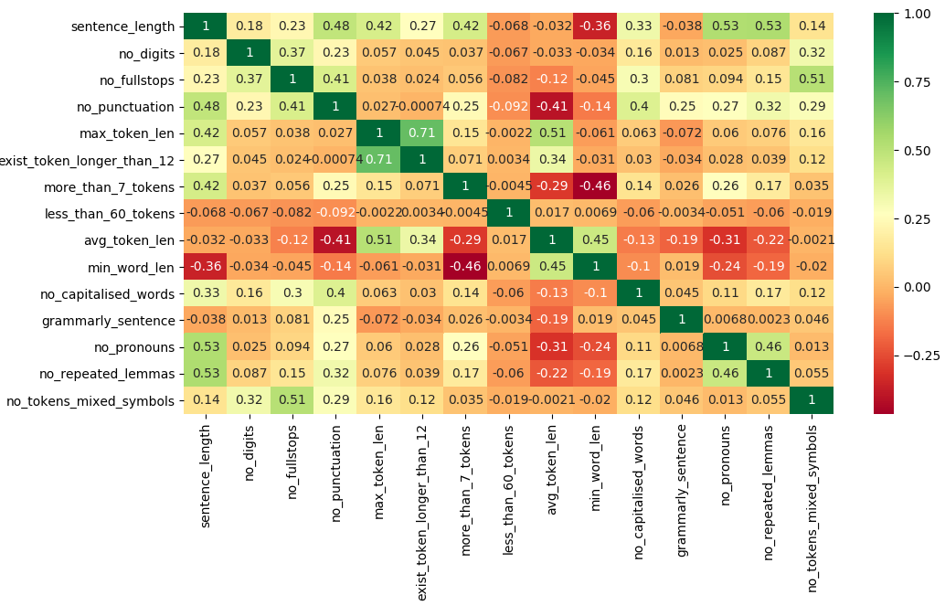
Preliminary Model for Identifying Good Dictionary Examples
The Pearson correlation matrix contains the correlation of features to manually assigned labels
The green color represents strong positive correlation, red strong negative correlation, and yellow no correlation
Removing irrelevant features (those that have very low correlation with label, like avg_word_len, or those that are highly correlated with each other, such as max_word_len and max_token_len)
Representation of each sample with the shorter feature vector
Feature analysis and feature selection

Slide 25
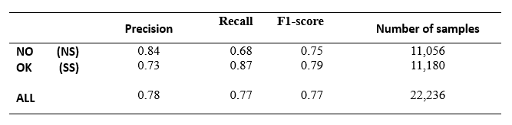
Preliminary Model for Identifying
Good Dictionary Examples
Gold dataset: training set (80%) and validation set (20%)
(NO non-standard; OK standard Serbian)
Results of the Logistic Regression binary classifier
The future system for semi-automatic identification of good dictionary examples implies development of more modules
  user interface for feature extraction
  fine tuning for GDEX parameters
  integration with corpus
Evaluation of first results of the developed core components is encouraging

Slide 26
Future work and concluding remarks
Positive first results motivate further detailed analysis of other features and introduction of new ones
An improvement of the weighted measure of features will follow, with a combination of expert knowledge and data training results
Implementation of other features and criteria will be integrated into the web application and selecting parameters and features to be calculated will be enabled
Full system integration will combine the use of the lexical database with corpora exploitation via the developed web service and software
Since the work on the digitization of other volumes of the SASA dictionary is continuing, more data are expected to bring refined conclusions
The extraction and ranking evaluation task will be assigned to more lexicographers, with parallel evaluation and interrater agreement checking

Slide 27
Acknowledgements
This research was partially supported by the Serbian Ministry of Education and Science grants #178009, #III 47003 and #178003.
The University of Belgrade Faculty of Mining and Geology – observer in ELEXIS project
thank you for your attention
obrigado pela atenção
хвала на пажњи
hvala na pažnji

